Slide 1

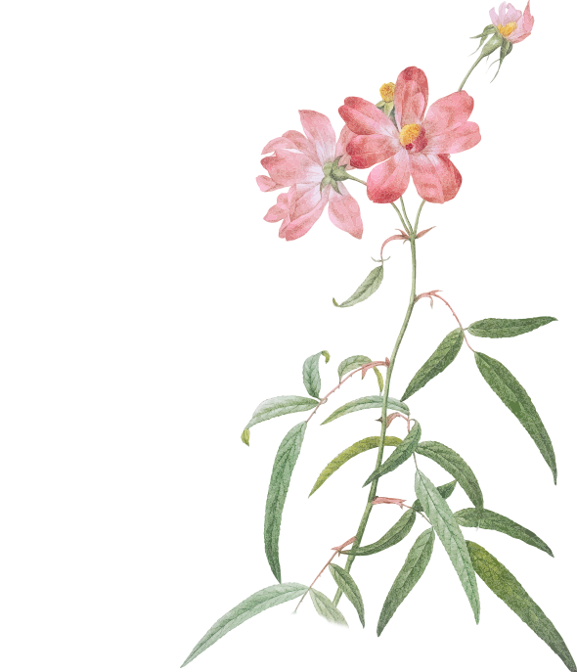
中考复习指导
词法篇
系动词和数词
指导教师：张艳
天津市枫林路中学宣娜

Slide 2
目录
1
系动词
2
数词

Slide 3
part 01
系动词

Slide 4
part 01
实义动词
助动词
1
2
3
4
系动词
情态动词

Slide 5
part 01
1
系 动 词 | 用来帮助说明主语的动词，它本身有词义，但不能单独用作谓语 | be，seem，look，become，get，grow，feel，turn

Slide 6
part 01
系动词的分类 | 例句
一“是”：be+形容词 | I am happy./ She is beautiful. / They are young.
二“好像”：____ + ____ | He seems right. 他似乎是对的。
三“保持”：keep/______+_______ | It is important to keep/ stay healthy.保持健康是重要的。
四“变”：become/ get /_______+_______ | He became happy after that. 自那以后，他变得开心了。 It is getting dark. 天快要黑了。 The leaves turn yellow in autumn. 秋天，树叶变黄了。
1
seem adj.
stay adj.
turn adj.

Slide 7
part 01
1
五“感官”： feel 感觉起来 sound 听起来 taste 品尝起来 smell 闻起来 look 看起来 | This cloth feels soft. 这布感觉起来很柔软。 The music sounds nice. 这首歌听起来很美妙。 This dish tastes delicious. 这道菜品尝起来美味。 It smells bad. 闻起来糟糕。 The watch looks beautiful. 这块表看起来漂亮。
总结：系动词后面+__________
adj.

Slide 8

part 01
练习巩固
1.2017年河西结课
--- Do you like swimming in winter?
--- Of course. The water cold
at first , but then I am warm and full
of energy.
A. feels B. tastes
C. smells D. look
1

Slide 9
part 01
练习巩固
2.2017年河西二模
--- 3D printing could be used to build
a house in less than 24 hours.
--- It amazing. It's my first time
to get to know this.
A. sounds B. smells
C. tastes D. feels
1

Slide 10
part 01
练习巩固
3.2019年河西结课
--- Dinner is ready. Help yourself !
--- Wow! It delicious.
Could you please tell me how to cook it?
A. becomes B. tastes
C. sounds D. feels
1

Slide 11
part 01
中考链接
1.2016天津 36题
---Would you like to try some pizza?
--- Yes,please. It lovely and nice.
A. becomes B. tastes
C. sounds D. feels
1

Slide 12
part 01
中考链接
2.2017年天津 35题
--- The cheese doesn't good.
Why don't we go to buy some fresh cheese?
--- Sounds great!
A. see B. find
C. sounds D. taste
1

Slide 13
part 01
中考链接
3.2016年天津书面表达（本大题共15分）
假如你所在中学的校刊近期开辟英文专栏，征集发生在大家身边的感人故事。请根据以下提示，为该专栏投稿。
（1）在一个寒冷的早晨，你买早餐时看到前面的女孩买了面包和牛奶。
（2）女孩要离开时，发现树下有一个老年乞丐，他看上去又冷又饿。
（3）女孩走到乞丐身旁，把食物递给了他。
（4）乞丐向女孩道谢，女孩微笑着离开。
（5）你很感动……
参考词汇：乞丐 begger 感动 be moved
要求：
（1）词数：80 ~ 100个。
（2）开头已给出，不计入总词数。
（3）要点齐全，行文连贯，可适当发挥
1

Slide 14
part 01
中考链接
3.2016年天津书面表达范文
a. He looked so cold and hungry that the girl wanted to help him.
b. At that moment, I was moved. I felt the touch of something bright and friendly.
1

Slide 15
part 02
数词

Slide 16
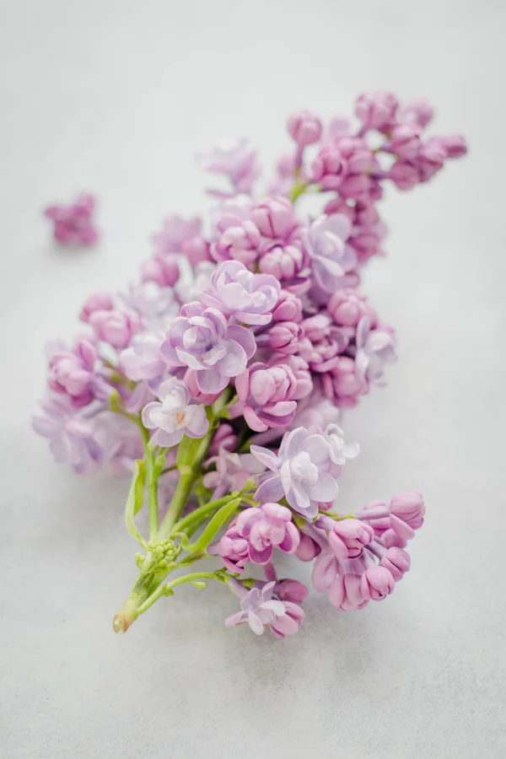
part 02
数
词
基数词
数量
序数词
顺序
数词的用法

Slide 17
一.基数词、序数词的构成
part 02
基数词 | 序数词 | 基数词 | 序数词
one |  | twelve
two |  | twenty
three |  | twenty-one
four |  | forty
five |  | one hundred
six |  | one hundred and five
eight |  | one hundred and twenty-nine
nine |  | nineteen
first
twelfth
second
twentieth
third
twenty-first
fourth
fortieth
fifth
one hundredth
sixth
one hundred and fifth
one hundred and twenty-ninth
eighth
ninth
nineteenth

Slide 18
part 02
基数词三位数 的构成
and
729
7
29
hundred
hundred
and
seven
twenty-nine

Slide 19
part 02
基数词 1，000以上数目,
从右向左每三位用“，” 分开
分别读为thousand , million, billion
千 百万 十亿
and
,
,
431
6
500
,
7
29
hundred
thousand,
billion,
million,

Slide 20
二.基数词的基本用法
part 02
1.hundred, thousand, million 和billion 的表示方法
a．hundred, thousand, million, billion前有具体数目时，用单数形式，不加­s。
five hundred students 500名学生
b．表示不确定数目时，要在它们的词尾加­s，且要与of连用。
thousands of 数以千计的，成千上万的
millions of 数以百万计的，数百万的
注意：此种结构前面可以用many、several修饰,但不能与具体数目连用。
many hundreds of birds 数以百计的小鸟

Slide 21
part 02
2.基数词的复数形式可用来表示世纪年代
20世纪90年代
in the
nineteen
nineties
in the 1990s/1990's
3.基数词的复数形式可用来表示一个不确定的年龄
in one’s +整10数的复数形式
in his fifties
在他50多岁时

Slide 22
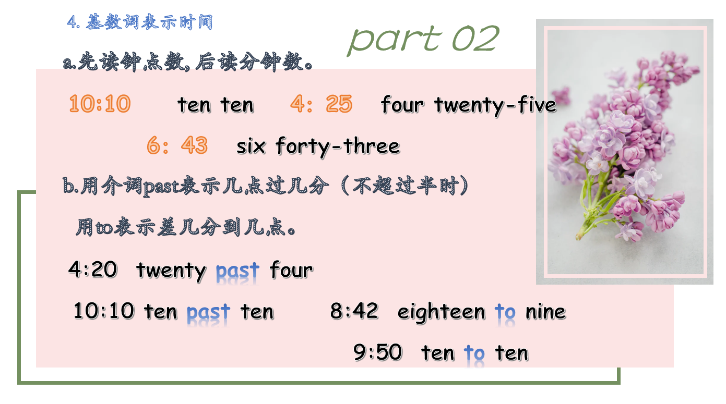

Slide 23
part 02
5.表达百分数、小数
基数词 + percent
80 %
eighty percent
three point seven eight
3.78
zero point zero four
0.04

Slide 24
part 02
6.表示编码
一般编码用 名词 + 基数词
207房
三年级一班
第五部分
第一课
Room 207
Class One Grade Three
Part Five
Lesson One

Slide 25
part 02
7.加减乘除表达法
加 | and/plus | 6＋4＝10 Six and/plus four is ten.
减 | minus | 8－3＝5 Eight minus three is five.
乘 | times | 3×3＝9 Three times three is nine.
除 | divided by | 18÷9＝2 Eighteen divided by nine is two.

Slide 26
part 02
8.倍数表达法
一倍 once，两倍 twice，
三倍 three times (三倍或以上 基数词＋times)
This box is five times as big as that one.
=This box is four times bigger than that one.
1. A + be + 倍数 + as +adj.原+ as +B.
A是B的 …倍…
2. C + be + 倍数 + adj.比+ than +D.
C比D … …倍

Slide 27
part 02
9.年月日表达法
a.月日,年
在2008年10月1日→写作on October 1st, 2008
on October the first, two thousand and eight
月
(首字母大写)
日
the + 序数词
年
（两位两位读）
月日与年之间用逗号分开
b. 月日 在8月9日
c.月年 在2010年5月
写作on August 9(th)
写作in May, 2010
有日用 on; 无日用in

Slide 28
二.序数词的基本用法
part 02
1.在使用序数词时，通常前面要
加定冠词the.
The second lesson is more difficult than the first.

Slide 29
part 02
2.序数词前面出现不定冠词a/an时，
表示“再一，又一”。
a.We’ve tried it three times.
Must we try it a fourth time？
b.His parents have two children,
but they want a third one.

Slide 30
part 02
3.序数词前有物主代词或所有格时
不用任何冠词。
a.This is my first job.
b.Mr. Black’s second child is called Lucy.

Slide 31
part 02
4.和基数词一起表示分数
1
5
分子 基数词
分母 序数词
one fifth
2
7
分子 ﹥ 1
分母 + s
two sevenths
a quarter\one fourth
1
4
分子 a\one
分母 quarter\fourth
3
4
three quarters
three fourths
1
2
a half

Slide 32
part 02
练习巩固
1.2018年河西二模
The ______ question is much more difficult than this one.
A.six B.sixth
c.sixteen D. sixty

Slide 33
part 02
练习巩固
2.My uncle bought me an iPhone for my ______ birthday.
twelve B. twelfth
C. the twelve D. the twelfth

Slide 34
part 02
练习巩固
3.______ of the land in that
district ______ covered with
trees and grass.
Two fifths; is B. Two fifth; are
C. Two fifth; is D. Two fifths; are

Slide 35
part 02
中考链接
1.2015年天津25题
Basketball is so exciting that______ people play it for fun.
A.million B.two millions
C.million of D.millions of

Slide 36
part 02
中考链接
2.2016年天津25题
Li ming will be ______ .His parents are going to have a party for his______ birthday.
A.sixteen; sixteenth
B.sixteenth;sixteenth
C.sixteen;sixteen
D.sixteenth;sixteen

Slide 37
三.中考题型里面的数词
part 02
1.听力
2016年天津中考听力第6题和第11题
6.How many desks are there in
Betty’s classroom?
A. 30. B. 40. C. 50.
11. When was Sally born?
A. In 1998. B. In 2000.
C. In 2002.

Slide 38
part 02
2017年天津中考听力第5题和14题
5. How many students are there in Linda’s class?
A. 25. B. 35. C. 45.
14. When will Bob get to the tea party?
A. At 3:00 p.m. B. At 3:30 p.m.
C. At 4:00 p.m.

Slide 39
part 02
2018年天津中考听力第18题
18.How long does Zhang Hua read
English newspapers every day?
A. Fifteen minutes.
B. Half an hour.
C. An hour.

Slide 40
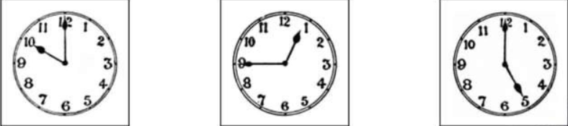
part 02
2019年天津中考听力第4题
4.

Slide 41
part 02
2.阅读理解
2018年中考阅读理解A篇26题和27题
(2018·天津)A篇
Dear Susan,
How are you? I’m going to visit Hong Kong with Mum and Dad next month. We’ll arrive on the second of August. It’s so exciting! We can meet each other soon!
I will spend a day in Ocean Park on the third of August. I know that you’ve visited Ocean Park many times before. Can you give me some advice on what to see in Ocean Park?

Slide 42
part 02
2.阅读理解
2018年中考阅读理解A篇46题和47题
(2018·天津)A篇
46. When will Lily arrive in Hong Kong?
A. On the second of August.B. On the third of August.
C. On the fourth of August.D. On the ninth of August.
47. How long will Lily spend in Ocean Park?
A. Half a day. B. One day.
C. One and a half days. D. Two days.

Slide 43

Thank you
for your listening!

